Slide 1
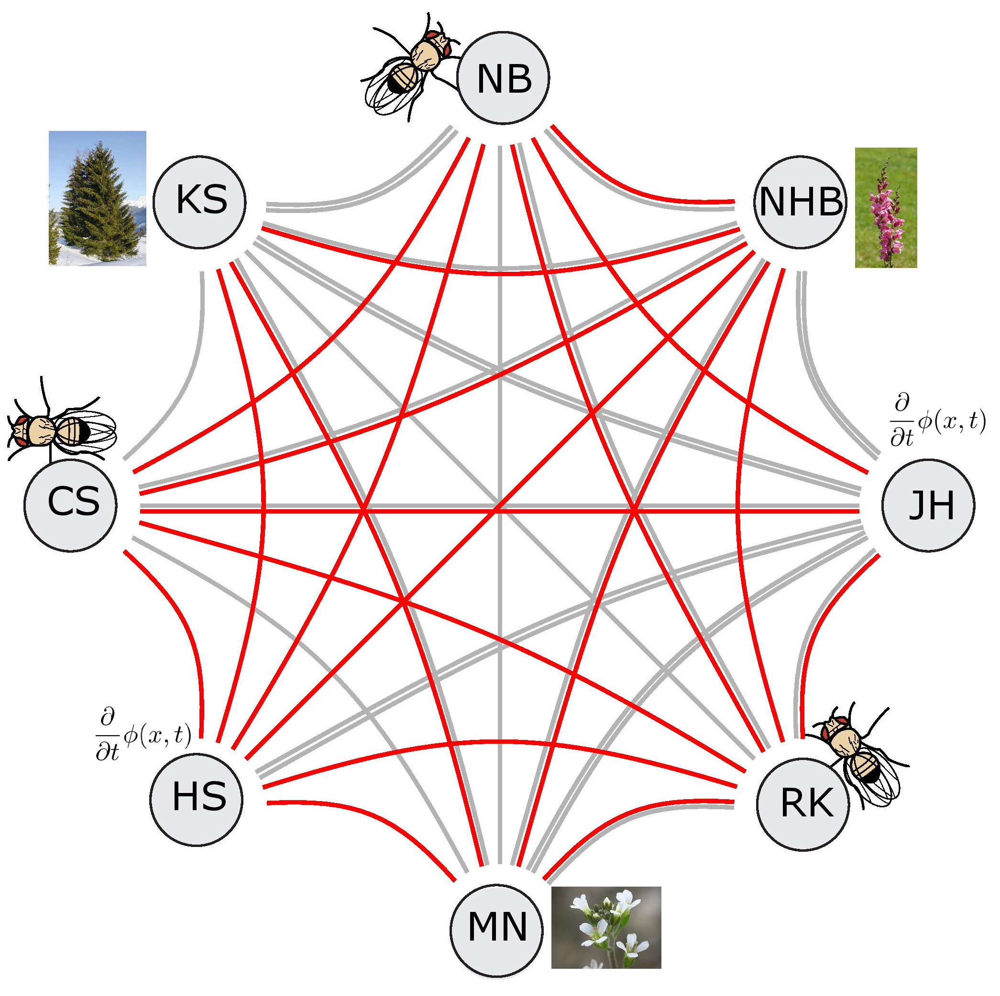
SFB POLYGENIC ADAPTATION: From single selected loci to the infinitesimal model Postdoc and PhD positions available!
Postdoc positions with Joachim Hermisson, Himani Sachdeva (Univ. of Vienna, AT), Magnus Nordborg (Gregor Mendel Institute, AT)
Evolutionary modeling
Genetics of local adaptation
Apply by June 04, 2023
PhD positions with Neda Barghi, Robert Kofler and Christian Schlötterer (Vetmeduni, Vienna, AT):
Characterizing the adaptive architecture of polygenic traits
Comparison of the genetic and adaptive architectures of polygenic traits
Genomic and phenotypic patterns of adaptation in large experimentally evolved populations
Understanding body size variation using experimental evolution
Understanding polygenic adaptation with reduced genetic variation
Characterizing the role of non-additive effects for adaptive responses
The role of genotype x environment interactions for adaptive responses
https://www.vetmeduni.ac.at/sfb-polygenic-adaptation
Salary: 4.351,90 EUR before tax (Postdocs); 2.464,80 EUR before tax (PhD students). Austrian Science Fund (FWF)

